Slide 1


Team 2
Bhavana Sri Maddina
Chuanyu Wang
Jesal Makwana
Nandita Krishnan
Randa Basta
Yidan Wang
Hotel Booking Demand Dataset
OPIM-5603-Statistics in Business Analytics

Slide 2
Problem Statement & Dataset Introduction

Slide 3
Dataset Introduction
The data is originally from Hotel booking demand dataset
It had written by Nuno Antonio, Ana Almeida, and Luis Nunes.
The dataset compares between a city hotel and resort hotel
dim(hotel_booking_data) # 119390 rows, 32 cols
City hotel is 66% of our dataset, and Resort hotel is 34%.
The dataset includes information about a city hotel and a resort hotel, such as; the booking date, length of stay, distribution channels, booking changes, the number of special requests, the number of adults/children, numbers of available parking spaces, etc.

Slide 4
Problem Statement
Goal
To find the best model for predicting booking cancellations at hotels and finding the best explaining variables for customers cancellation.
As a guest , there are many aspects would be considered when choosing a hotel. Predicting cancellation could be useful not only for customers, but for the hotels as well.–we’ve worked on a couple of possible questions through our project that helped us predicting our cancellation policy.
How many more bookings will be cancelled in the near future?
Which factors can explain these cancellations?

Slide 5

Data Pre-Processing & Visualization

Slide 6
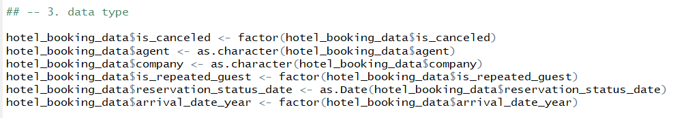
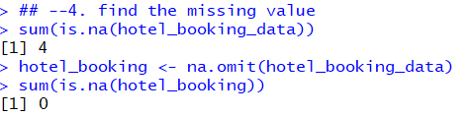
Changing Data Types & Finding Missing Values

Slide 7
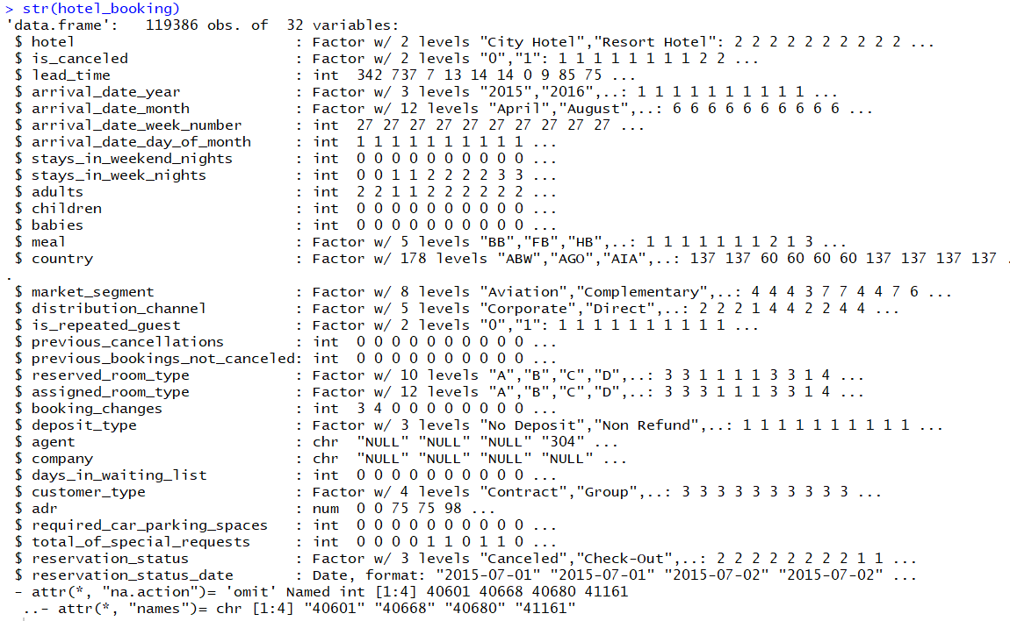

Slide 8
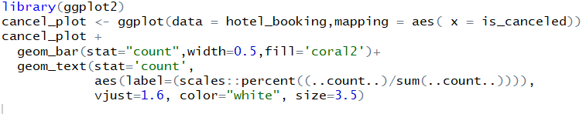
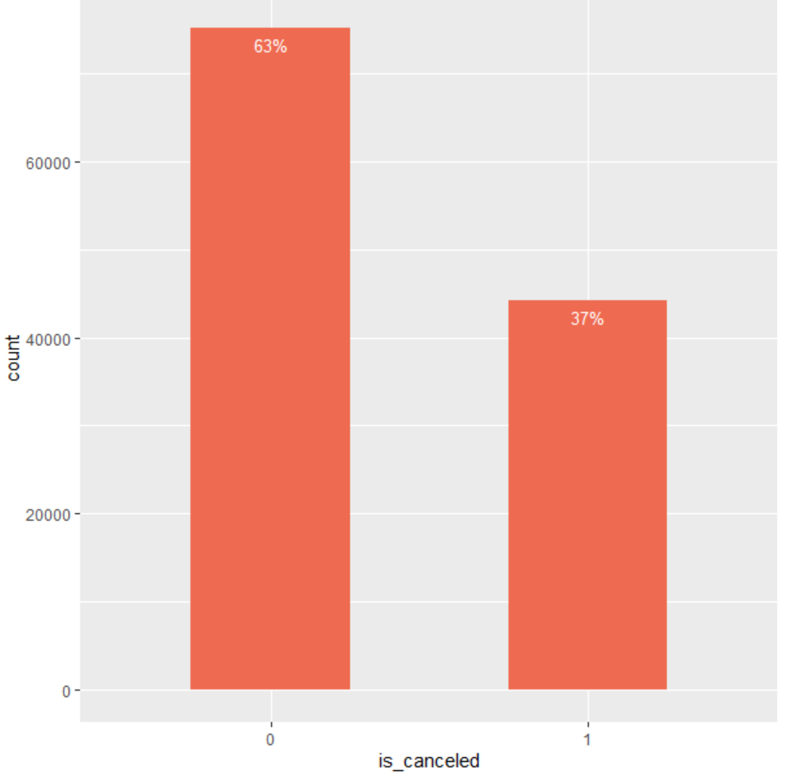
is_canceled – target variable

Slide 9
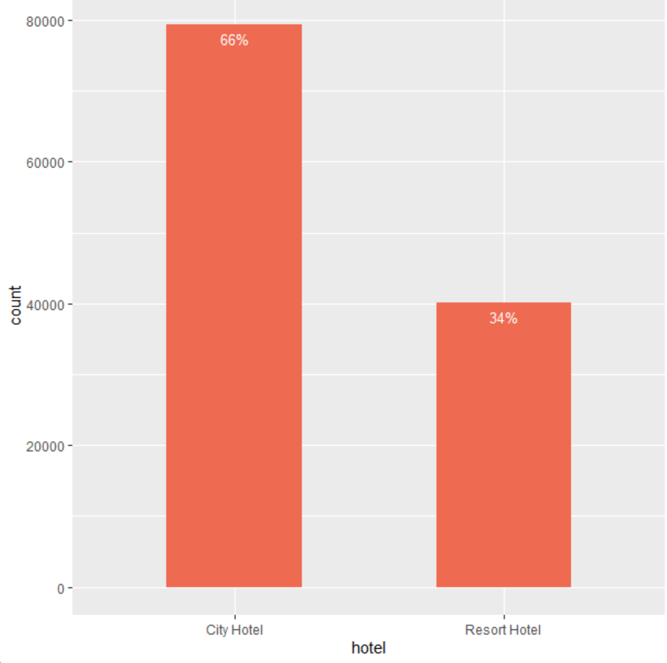
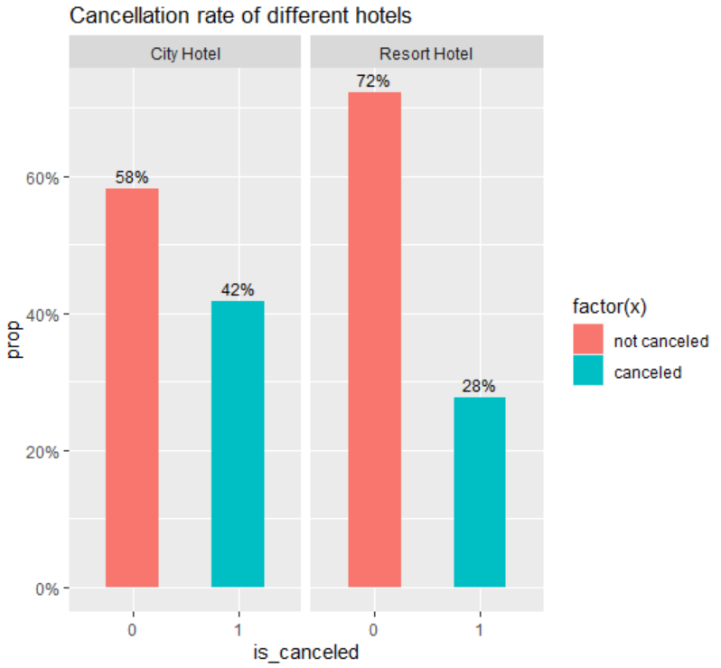
hotel - number of city & resort hotels from the dataset

Slide 10
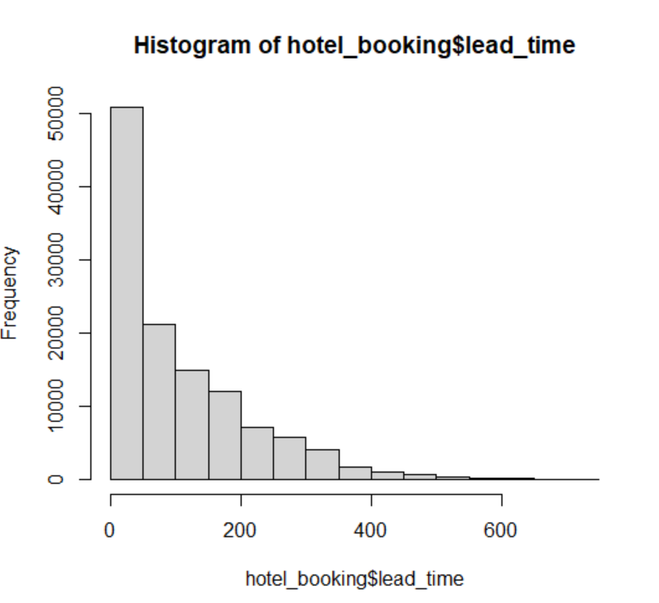
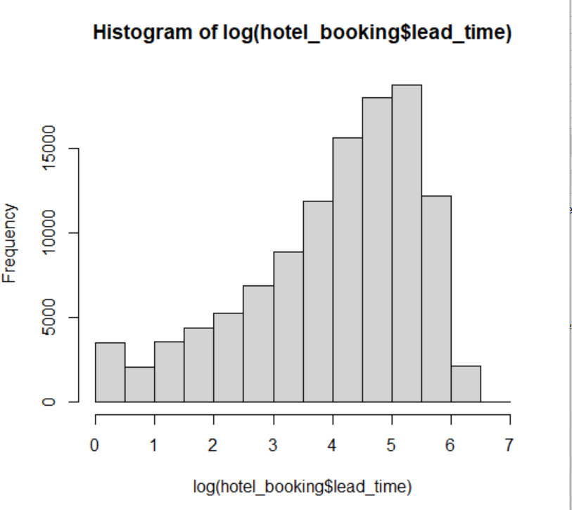
lead_time - number of days between the booking & arrival date

Slide 11
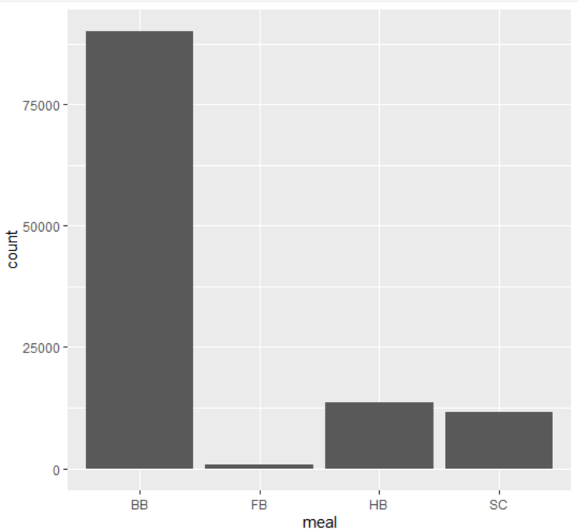
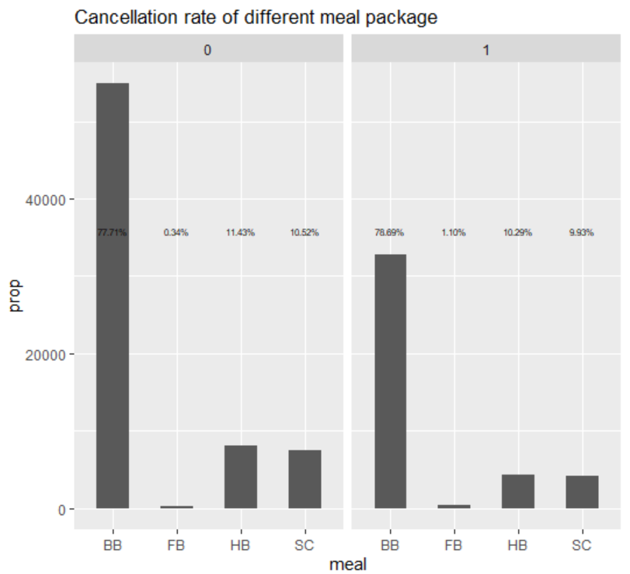
meals - type of meal booked : undefined/SC,BB,HB,FB

Slide 12
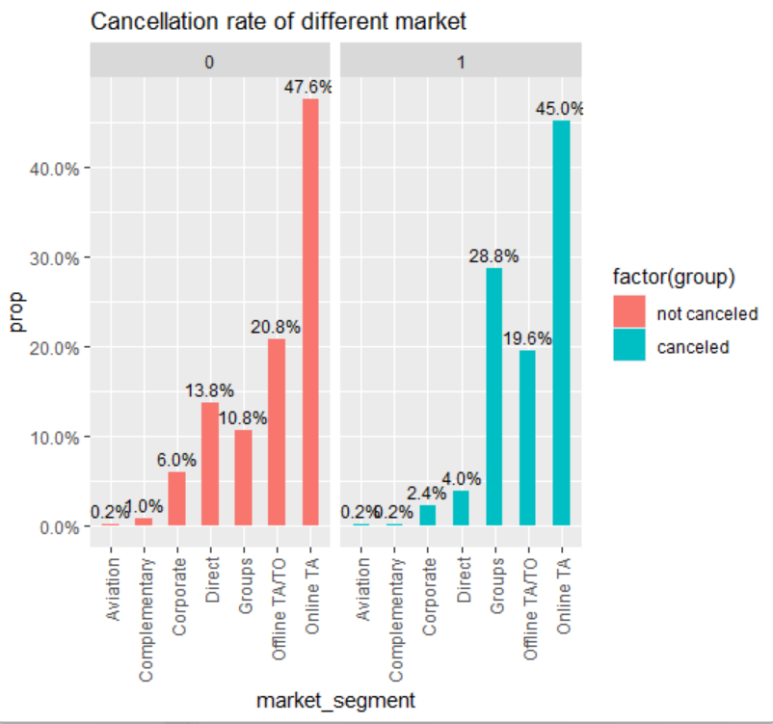
market_segment – market segment designation

Slide 13
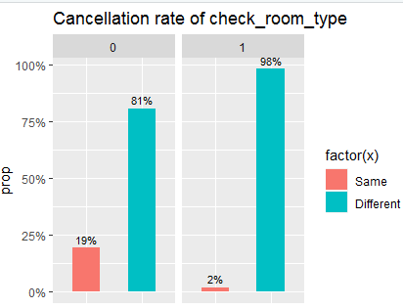
room_type - same as assigned room or different

Slide 14
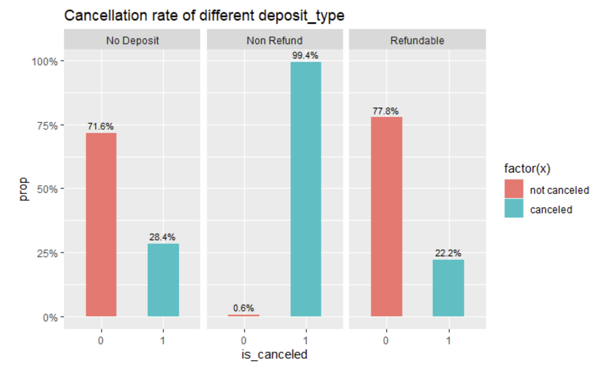
deposit_type – deposit type : no deposit, non refund, refundable

Slide 15
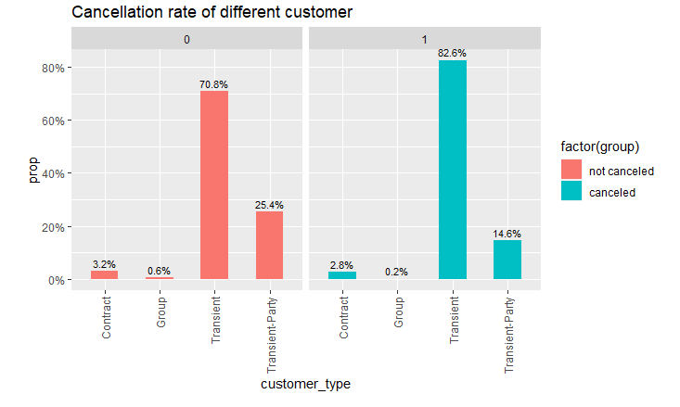
customer_type – contract, group, transient & transient party.

Slide 16
Data Modeling

Slide 17
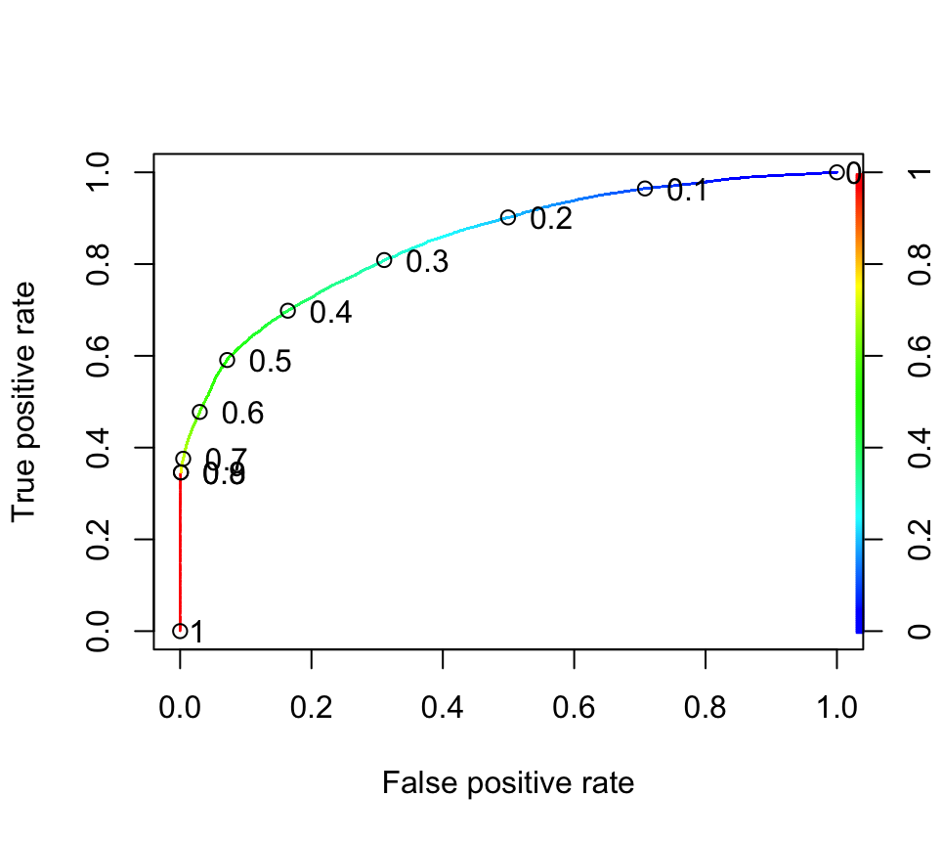
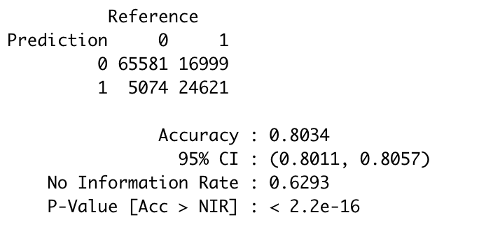
Logistic Regression - Model I
Accuracy = 80.34%
CONFUSION MATRIX

Slide 18
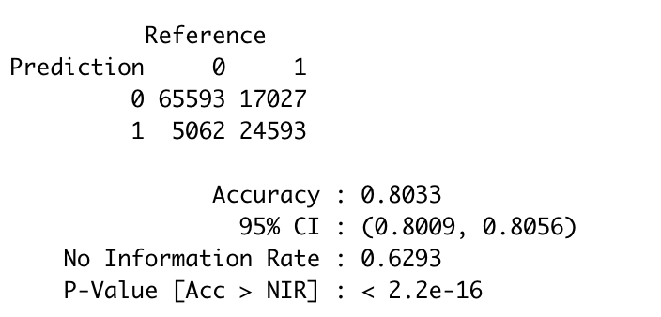
Logistic Regression - Model II
Accuracy = 80.33%
CONFUSION MATRIX

Slide 19
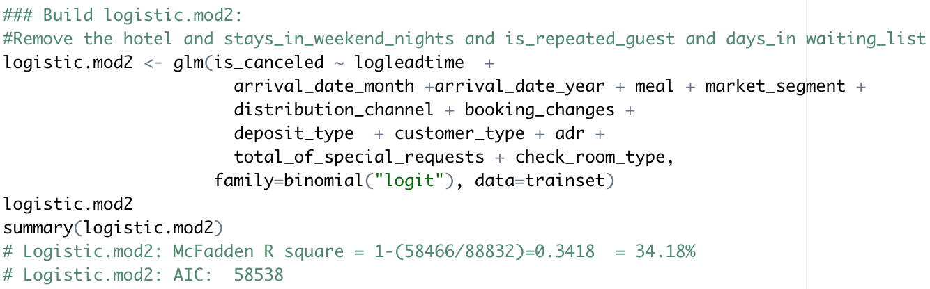
Final Model
Trade-off between Complexity and Accuracy

Slide 20
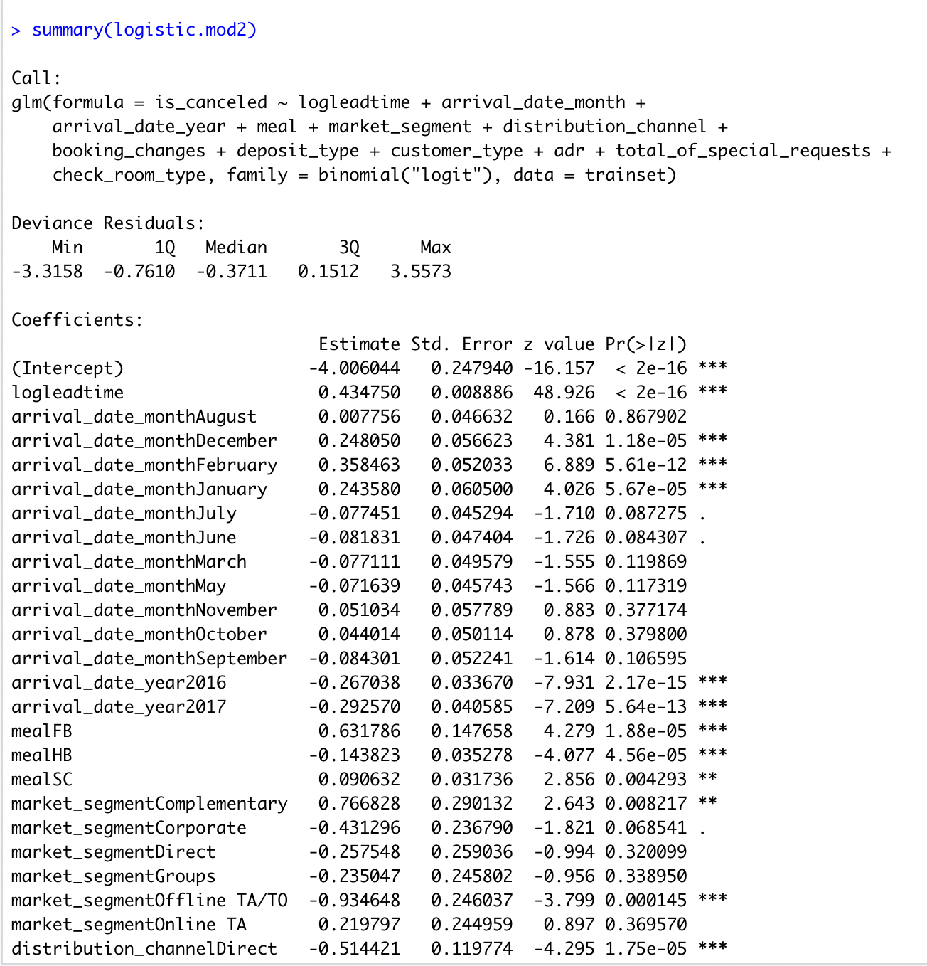

Slide 21
Conclusions & Recommendations

Slide 22
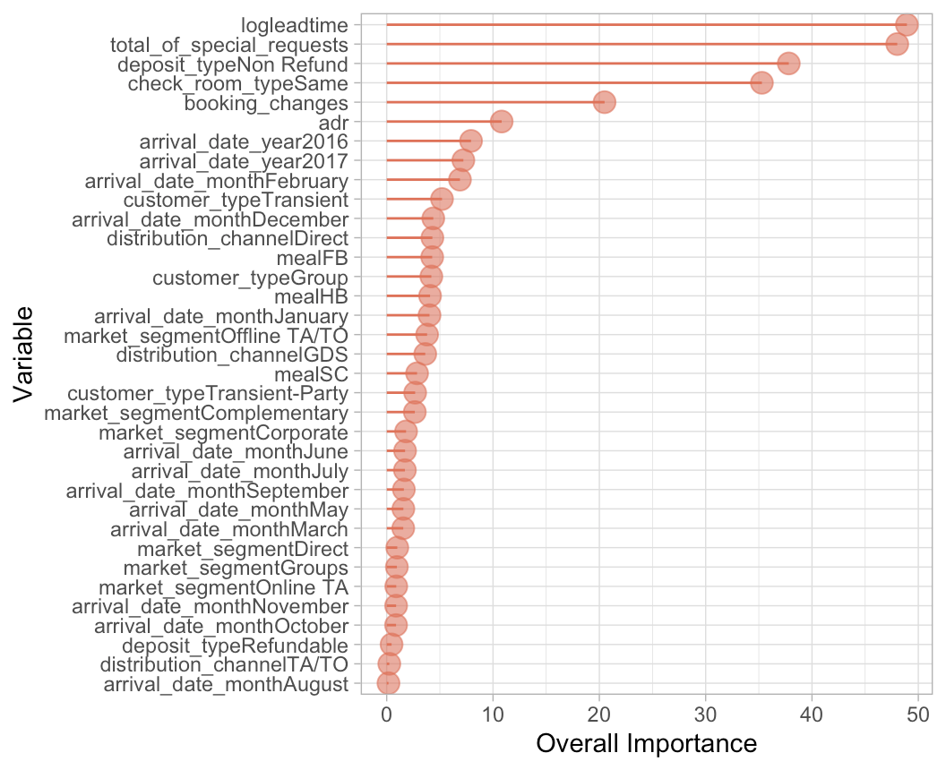
Conclusions
Variables impacting booking cancellations :
Number of Special Requests
Deposit Type
Changes in Assigned Room

Slide 23
Business Requirement : To reduce the number of cancellations
Recommendations :
Assigned Room Type:
Any changes to the assigned room type must be avoided as this could lead to frustration among customers and eventually lead to cancellation of the booking.
Deposit Type:
Deposit type should be made non-refundable for special occasions like holidays/festivities or all luxury rooms in general, as it urges customers to go through with their booking.

Slide 24
Thank you!

